Slide 1
Messageboardapp on Istio Canary Deployment
Grafana, kiali, prometheus dashboards
Monica Marshall October 19, 2020

Slide 2
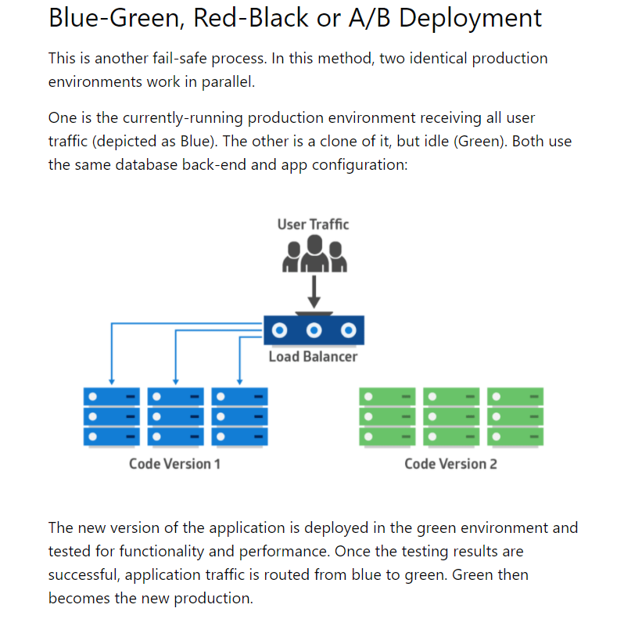
Blue-Green, Red-Black or A/B Deployment

Slide 3
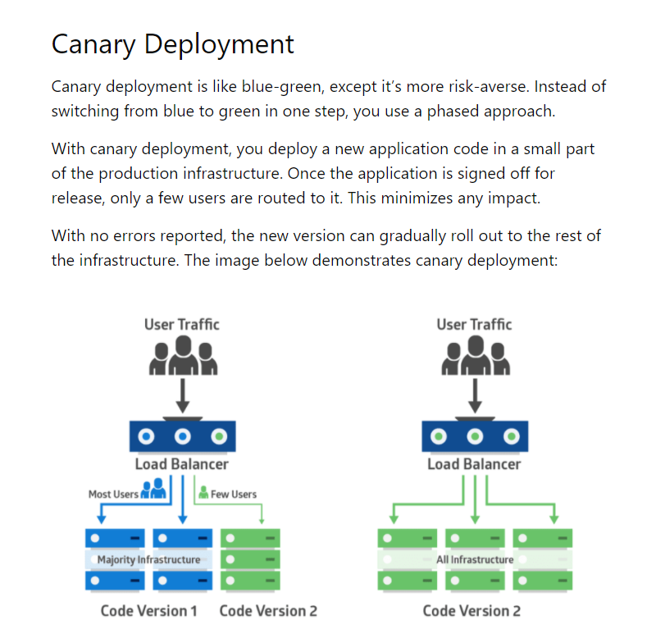
Canary Deployment

Slide 4
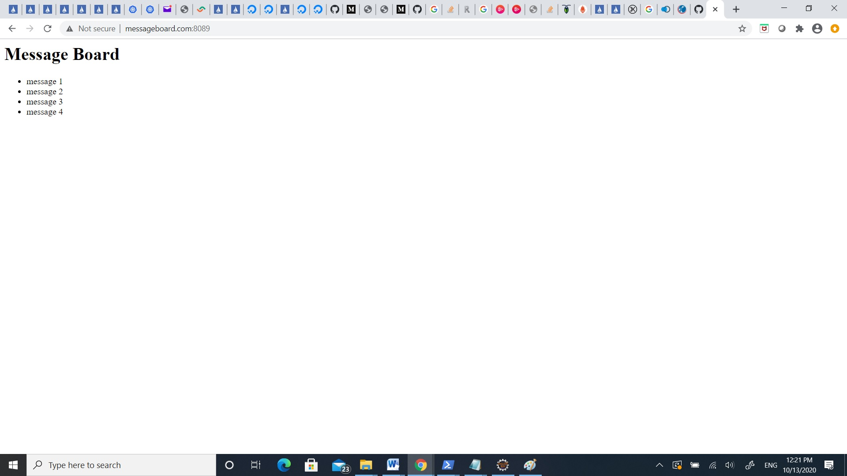
Messageboardapp v1

Slide 5
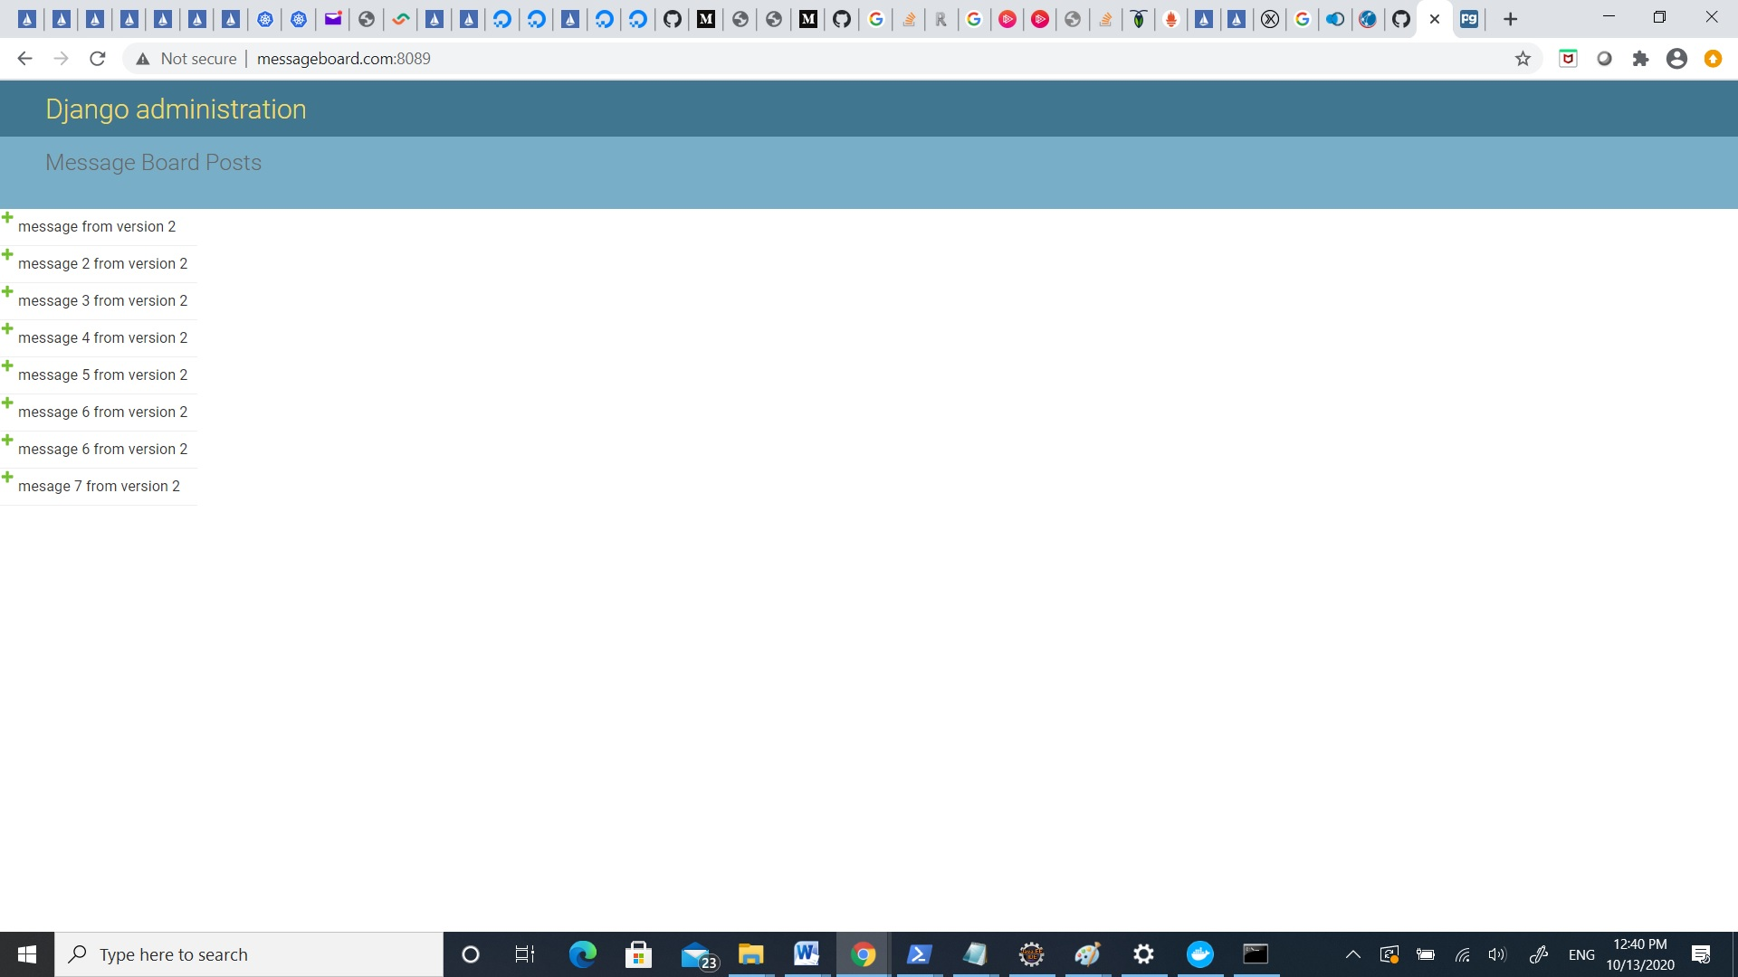
Messageboardapp_v2

Slide 6
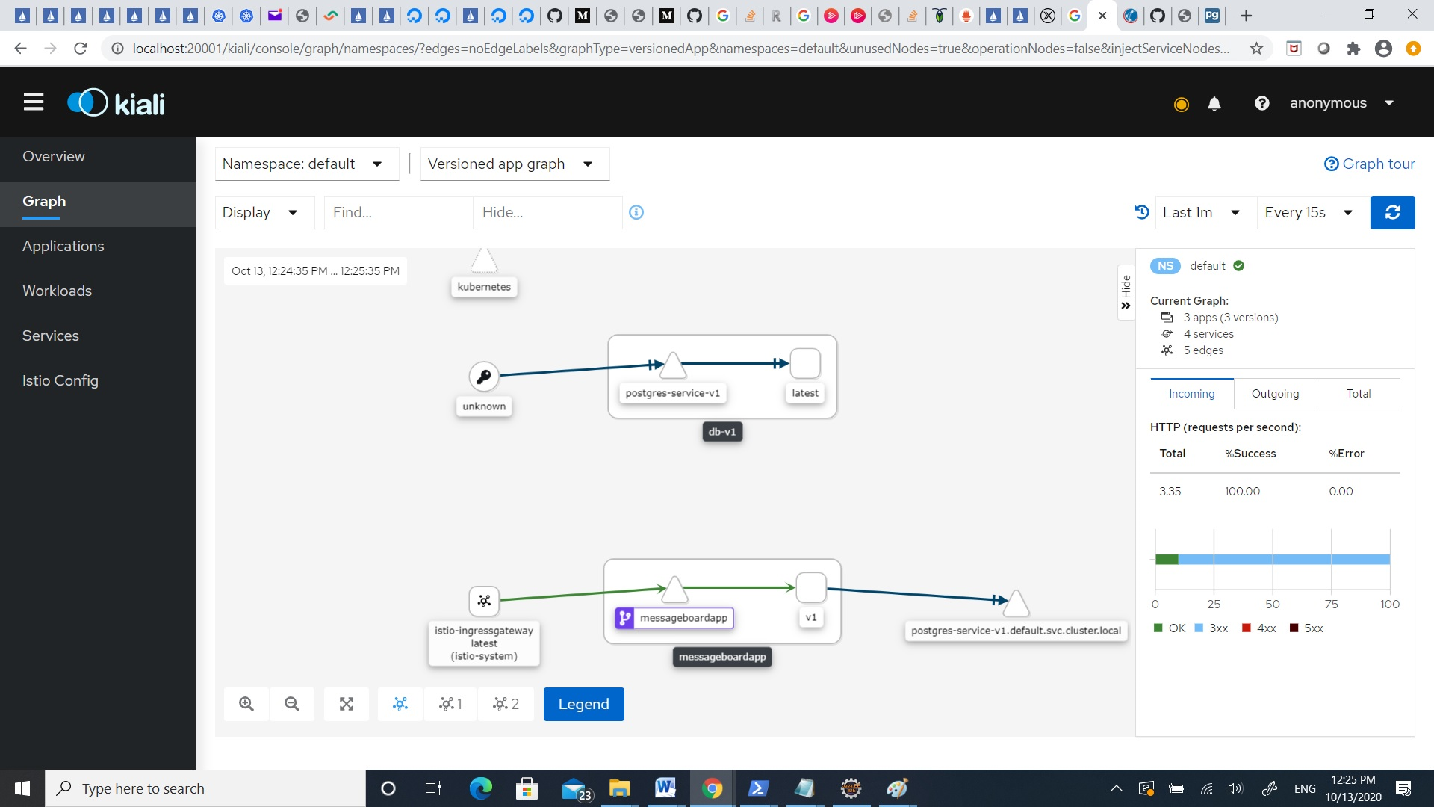
MessageBoardApp v1 Istio - Kiali

Slide 7
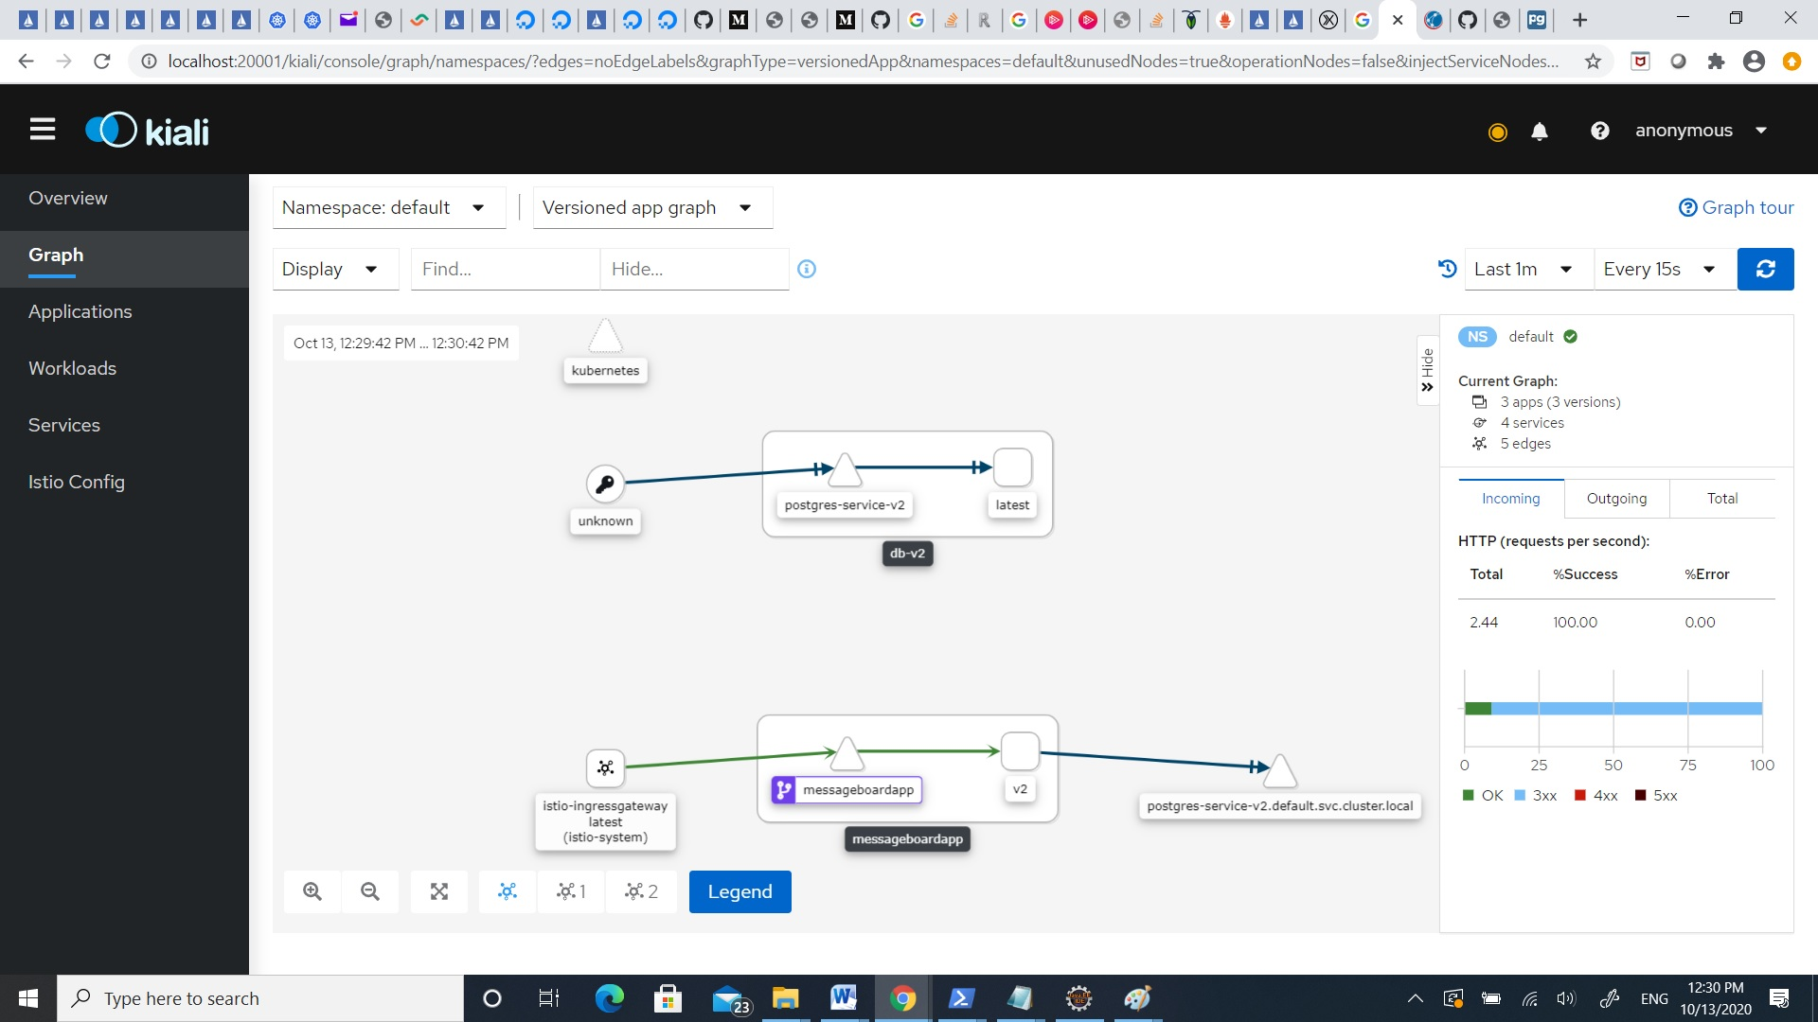
MessageBoardApp v2 Istio - Kiali

Slide 8
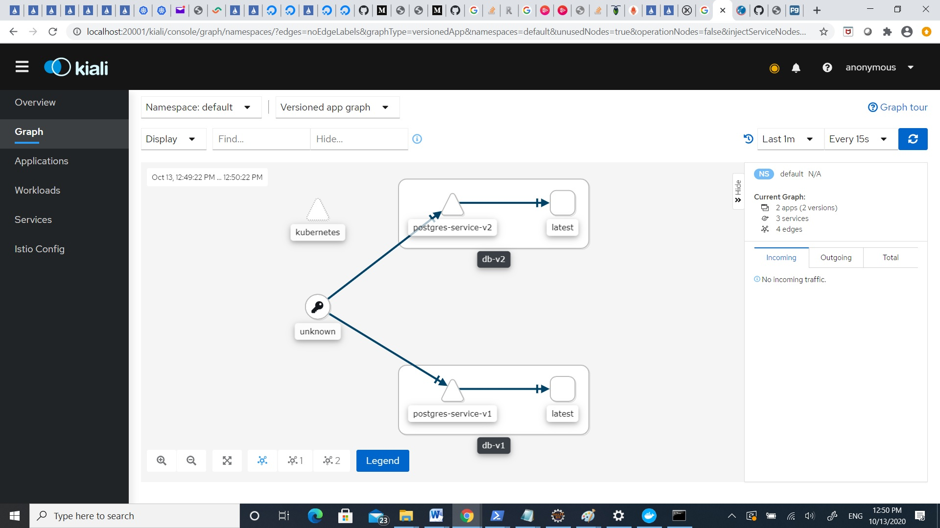
DB v1/DB v2 Istio - Kiali

Slide 9

MessageBoardApp v1/v2 Istio - Kiali

Slide 10
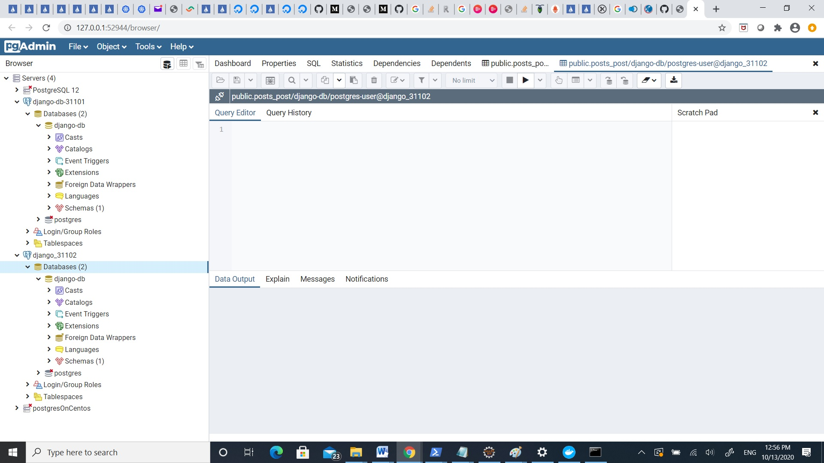
Postgres client view DB v1/DB v2

Slide 11
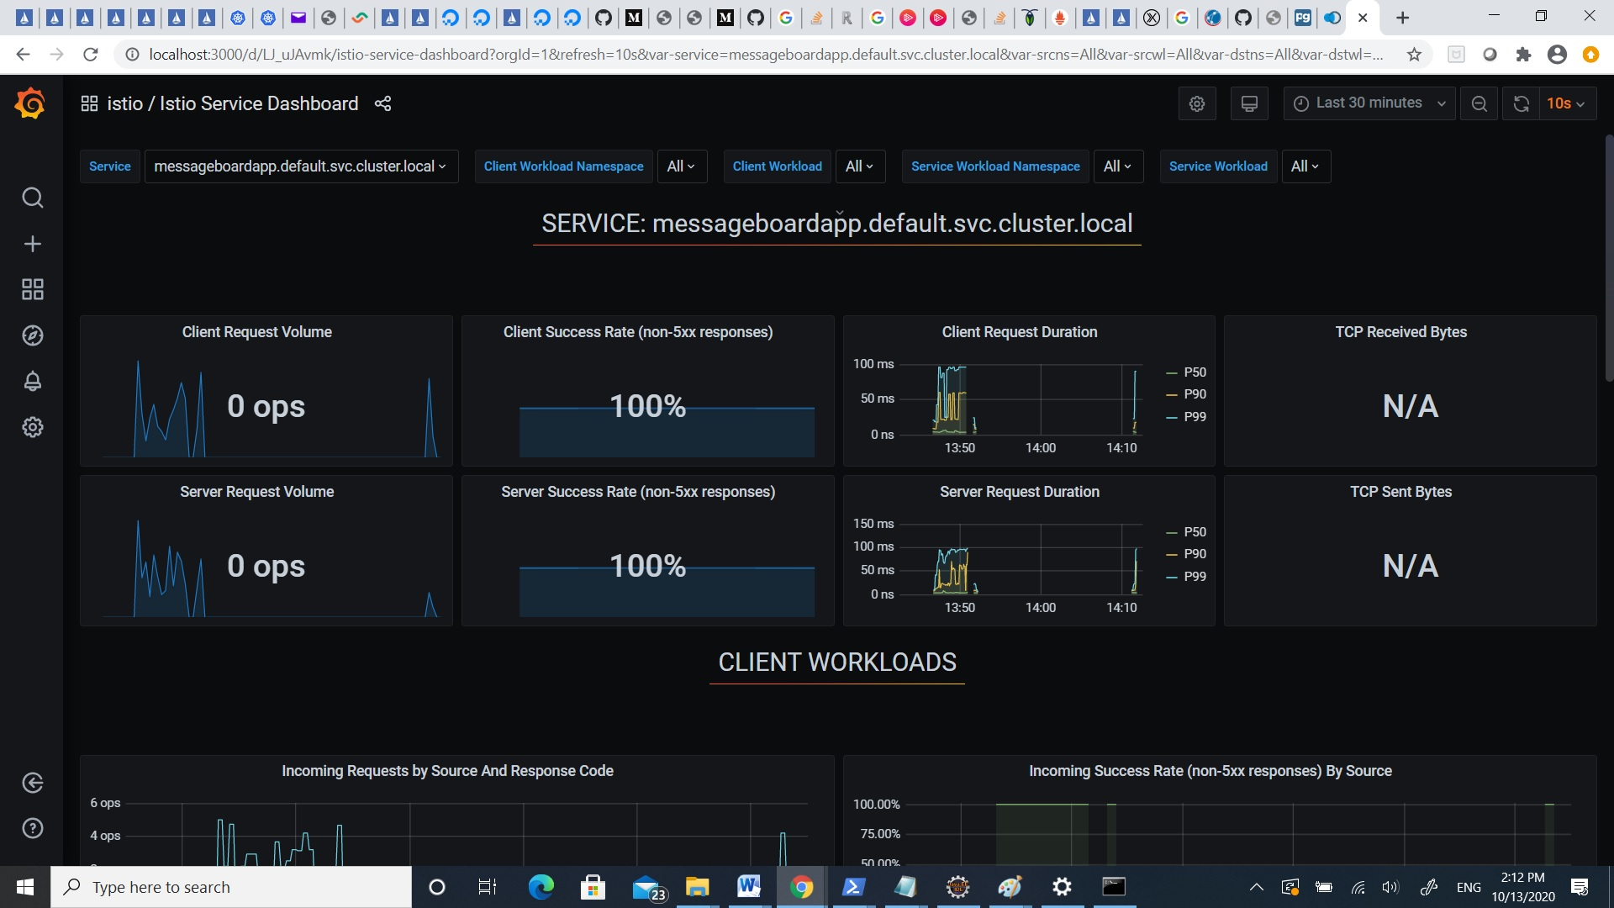
MessageBoarApp – Grafana - service

Slide 12
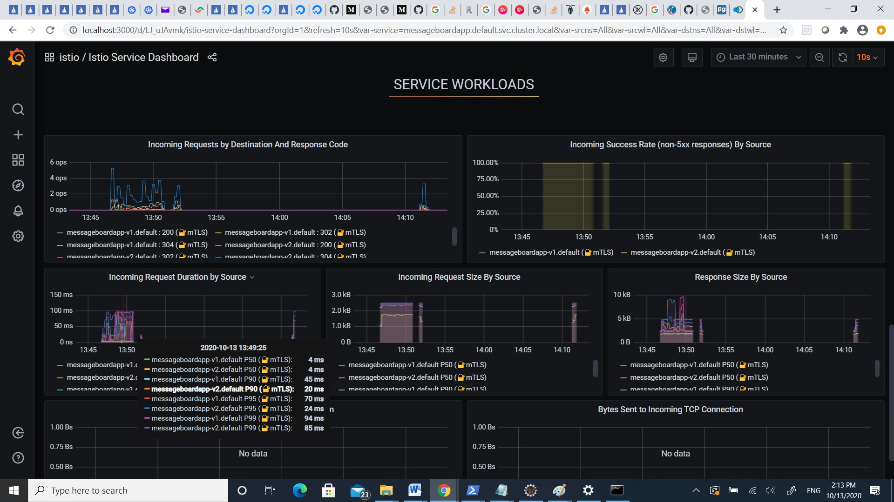
MessageBoardApp Grafana – service workloads

Slide 13
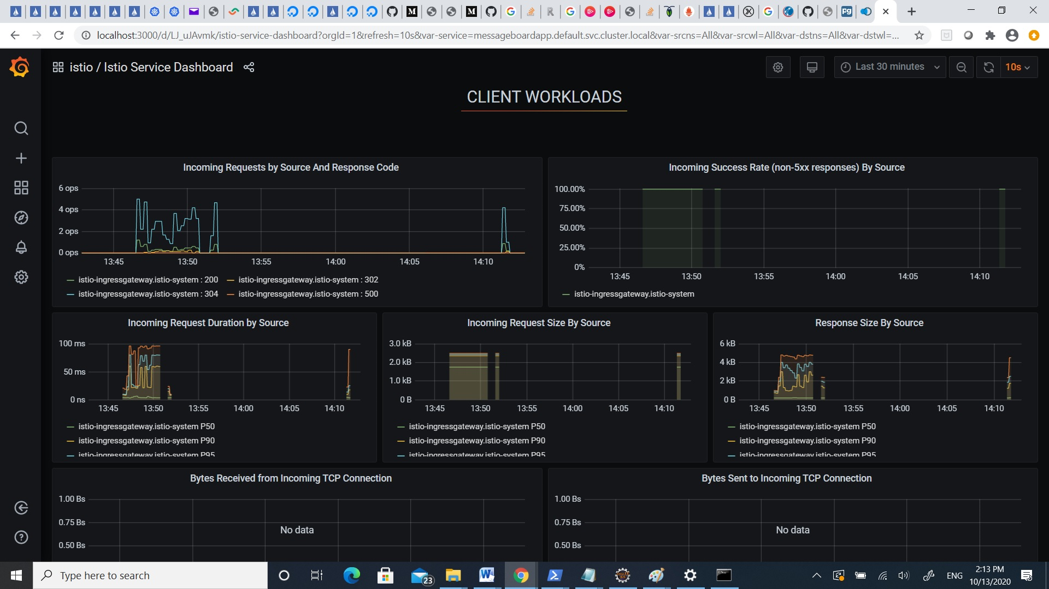
MessageBoardApp Grafana – client workloads

Slide 14
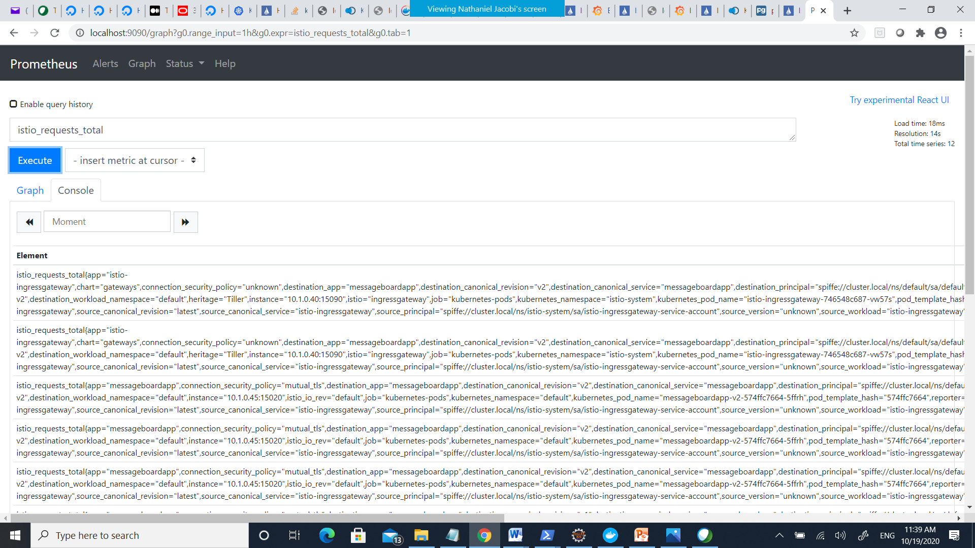
Prometheus Dashboard

